Slide 1


Presentation Title
Damian Mulvena
2025-03-06

Slide 2
Outline
Executive Summary
Introduction
Methodology
Results
Conclusion
Appendix

Slide 3
Executive Summary
Summary of methodologies
Summary of all results

Slide 4
Introduction
Project background and context
Problems you want to find answers

Slide 5

Methodology - Section
Section 1

Slide 6
Methodology
Executive Summary
Data collection methodology:
Describe how data was collected
Perform data wrangling
Describe how data was processed
Perform exploratory data analysis (EDA) using visualization and SQL
Perform interactive visual analytics using Folium and Plotly Dash
Perform predictive analysis using classification models
How to build, tune, evaluate classification models

Slide 7
Data Collection Overview
Primary data was SpaceX API collection, which provides details of Space-X launches
as maintained and documented in https://github.com/r-spacex/SpaceX-API
and accessed via http API requests at https://api.spacexdata.com/v4/launches/latest
Data on Space-X launches was also gathered from Wikipedia tables
from page https://en.wikipedia.org/w/index.php?title=List_of_Falcon_9_and_Falcon_Heavy_launches
which is accessed by Web-Scraping methods
In each case, the actual data used was a snapshot for course consistency

Slide 8
Data Collection – SpaceX API
Primary data collection involved making http request “Get” calls, to an API interface at api.spacexdata.com
Part of the process involved taking id values from the initially loaded data, and using these as lookups to retrieve additional detail
the GitHub URL of the completed SpaceX API calls notebook is
DSCapstone/jupyter-local-1.1a-spacex-data-collection-api-v2.ipynb at main · damianmulvena/DSCapstone
Retrieve data
make API request, to
API: launches
Reduce
to selected columns only
rows up to 2020-01-13
Enrich
Loop over rows, making API calls on ids as below
rockets/id, launchpads/id, payloads/id, cores/id
base URL: api.spacexdata.com/v4/
Wrap up
combine enrichment arrays to create new dataframe
drop Falcon-1 rows, and re-label flight numbers according to those rows that remain
replace missing values in payload column with mean

Slide 9
Data Collection – Scraping
In web-scraping we request an html page and parse it to extract relevant details, using the BeautifulSoup library to seek out the data elements of interest
the GitHub URL of the completed web-scraping notebook is
DSCapstone/jupyter-local-1.1b-webscraping.ipynb at main · damianmulvena/DSCapstone
Get Wiki page
Identify data
Find table structures, and select the 3rd one
Identify table rows having a Flight Number
“Scrape”
From each row, extract useful data to list
Data object
combine lists to a dictionary, and then
convert dictionary to a dataframe
Retrieve wiki page, in this case from a specific archived copy

Slide 10
Data Wrangling
Using dataset_part_1.csv, (nominally) from the API retrieval, we explored some aspects of the data
Missing values
Reported missing values as percentage
Only LandingPad had missing values, and for now this is expected and valid
Explored
Looked at number of launches by launch site
Looked at number of launches for each type of orbit
Looked at number of launches with each type of outcome
Added column to reflect outcomes
Created new column “class” to reflect successful or otherwise landing outcomes
the GitHub URL of the completed data-wrangling notebook is
DSCapstone/jupyter-local-1.2-spacex-data-wrangling-v2.ipynb at main · damianmulvena/DSCapstone

Slide 11
EDA with Data Visualization
Initially, scatterplots were created of Payload, FlightNo and Site combinations, in each case colouring the points by class (success):
Payload vs FlightNo (showing fewer failures in later flights and heavier payloads)
Site vs FlightNo (showing fewer failures in later flights, but more for CCAFS-SLC-40), and
Site vs Payload (which backed up findings from previous 2 plots)
Next plots looked at Orbit, finding that some orbit destinations had fewer fails:
Orbit vs average Class (bar, showing 100% success for 4 orbits)
Orbit vs FlightNo (reaffirming later flights as higher success)
Orbit vs Payload (reaffirming heavier payloads as higher success)
The last chart (AvgClass by Year) showed a steady rise in success over time
Finally, the discrete value columns were transformed into categorical columns
the GitHub URL of the completed EDA with data visualisation notebook is
DSCapstone/jupyter-local-2.2-eda-dataviz-v2.ipynb at main · damianmulvena/DSCapstone

Slide 12
EDA with SQL
SQL queries performed in analysis of launch data:
identify unique launch site names from the space missions
show 5 of the launch_site names beginning with “CCA” (Cape Canaveral)
total payload mass for boosters launched by “NASA (CRS)”
average payload mass for booster versions with “F9 v1.1”
date of first successful landing to a ground pad
List the boosters which landed to a drone ship with payload between 4000 and 6000
Give the total mission counts by success and failure
List the booster_versions which have carried the maximum payload
display month name, failure landing_outcome in drone ship, booster version, and launch_site, for launches in 2015
Rank the count of landing outcomes between the date 2010-06-04 and 2017-03-20, in descending order
the GitHub URL of the completed EDA with SQL notebook is
DSCapstone/jupyter-local-2.1-eda-sql-coursera_sqllite.ipynb at main · damianmulvena/DSCapstone

Slide 13
Build an Interactive Map with Folium
Using the launch data and mapping as provided with Folium library, I created:
Circle markers, with name popup (i.e. when clicked) to help identify or locate each of the sites
Map “DivIcon” Markers which placed a visible site name on the map at coordinates (no specific icon!)
A single marker cluster was added to the map, which contained
white Icon markers for each launch, with the icon core coloured green or red to denote success or failure
and with each icon linked to others of any given site by its latitude and longitude coordinates
A mouse pointer object was dropped to the map to help finding coordinates of a point
Nearest coastline (railway, road) location markers were created and labelled with distance to nearest site
PolyLine markers were then created joining the utility access points to the sites
Explain why you added those objects
Launch site and success/failure markers help us to understand site and success level
Access to services is important in determining the cost of running a site, so mapping these is important
the GitHub URL of the completed Folium mapping notebook is
DSCapstone/jupyter-local-3.1-launch-site-location-v2.ipynb at main · damianmulvena/DSCapstone

Slide 14
Build a Dashboard with Plotly Dash
The graphs and user-interaction controls are as follows:
A dropdown allows user to select either ALL sites, or a specific site
A RangeSlider control lets user control the payload range of interest in the 2nd graph
The first plot is a pie-chart, showing:
Total (count) of success, by site, across all sites (key is site-name), or
Proportion of success to failure for the selected site (key is success/fail)
The lower plot is a scatterplot of success (class) vs Payload Mass (key by Booster Version), whether filtered by sitename, or for all sites
These plots and controls allow user to more closely examine
Success vs Failure for different sites, payload mass ranges, or booster versions
the GitHub URL of your completed Plotly Dash lab is:
DSCapstone/spacex_dash_app.py at main · damianmulvena/DSCapstone

Slide 15
Predictive Analysis (Classification)
Different classification models were evaluated using GridSearchCV, a Cross Validation tool which checks a range of parameters for different estimators, using the same data, returning the best parameters and a score
X data was drawn from our dataset_part_3 file, which had categorised columns
Y was drawn from dataset_part_2, taking just the class “labelled” data
the train_test_split function was used to break X and Y into train and test (20%) sets
Then, for each of 4 estimators – LogisticRegression, SVM (Support Vector Machine), DecisionTreeClassifier and KNN (K-Nearest Neighbors) the following steps were taken:
Define parameters to be compared for the estimator,
Create a new estimator object
Pass parameters and the estimator object to GridSearchCV
Fit the data (using X_train, Y_train), returning a new predictor_cv object for the results
Score the results, using X_test, Y_test
Create a prediction yhat using X_test, and plot a confusion matrix of Y_test vs yhat
the GitHub URL of the completed predictive analysis lab is:
DSCapstone/SpaceX-Machine-Learning-Prediction-Part-5-v1-log2.ipynb at main · damianmulvena/DSCapstone

Slide 16
Results
Exploratory data analysis results
Interactive analytics demo in screenshots
Predictive analysis results

Slide 17

Insights drawn from EDA - Section
Section 2

Slide 18
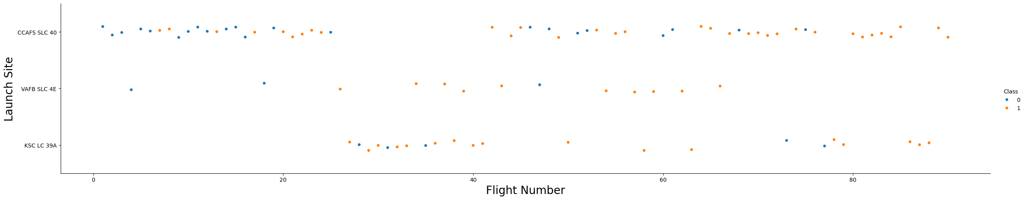
Flight Number vs. Launch Site
A plot of Flight Number vs. Launch Site, coloured by success or failure, shows that many of the failures occur for earlier flights

Slide 19
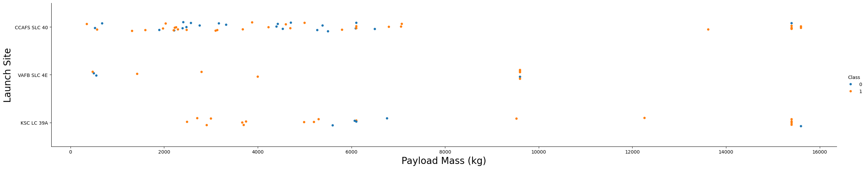
Payload vs. Launch Site
A plot of Payload vs. Launch Site shows fewer failures for greater payload mass

Slide 20
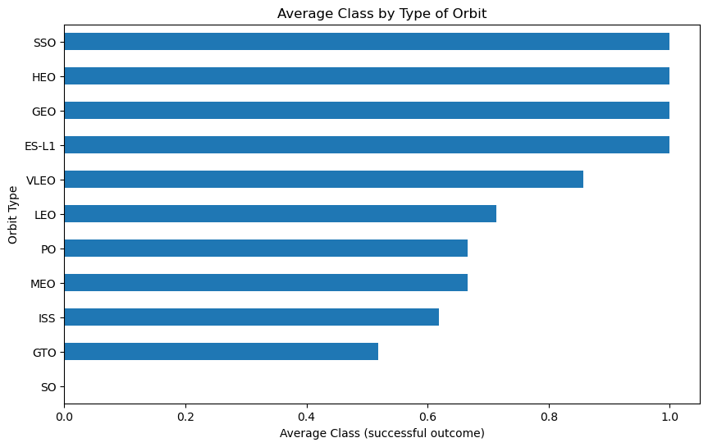
Success Rate vs. Orbit Type
From a bar chart displaying success rate for each orbit type, it’s clear that some orbits have more successful outcomes than others

Slide 21
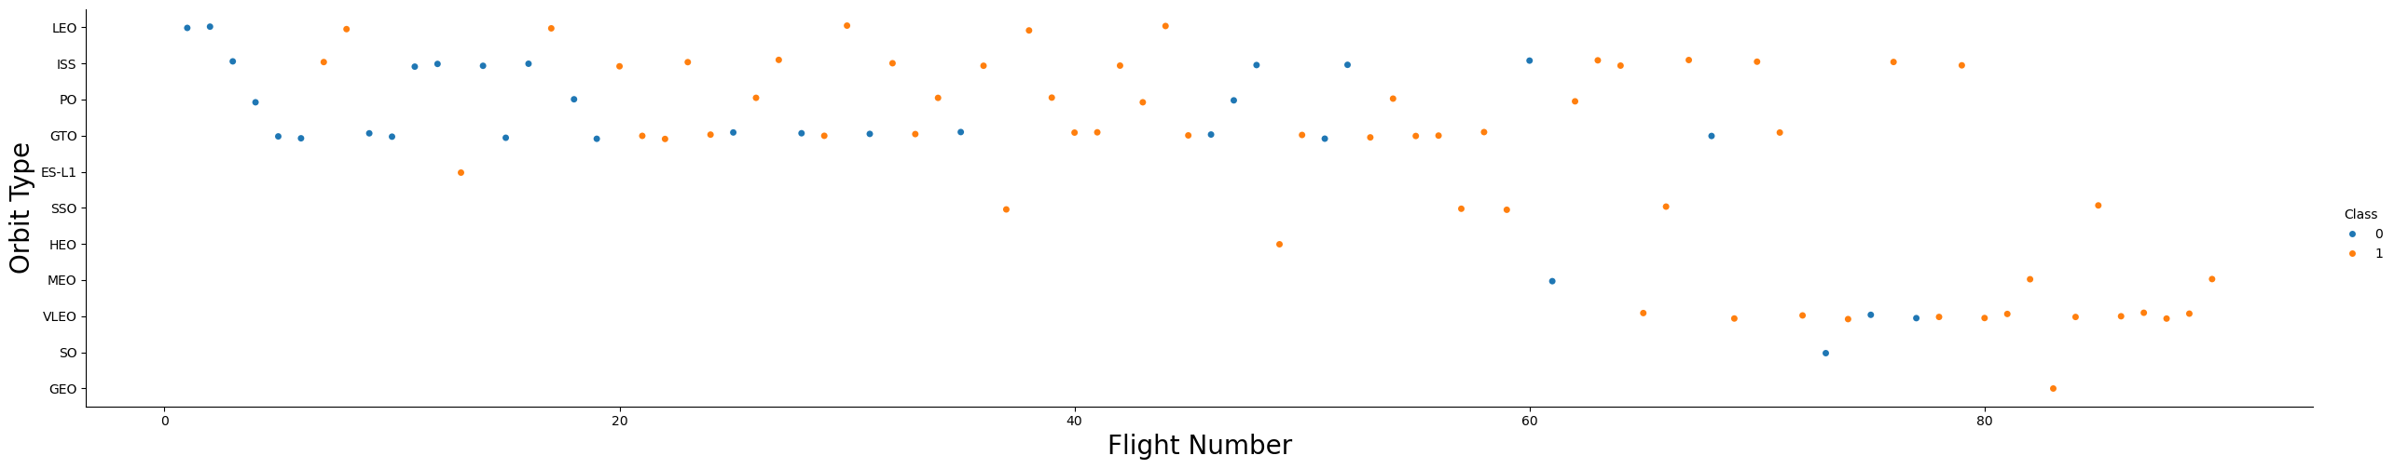
Flight Number vs. Orbit Type
A scatter point of Flight number vs. Orbit type shows once more that earlier flights are more prone to failure
It also makes it clear that some “100%” success rates (on the previous plot) are a bit artificial, as some orbits include too few launches for this to be predictive

Slide 22
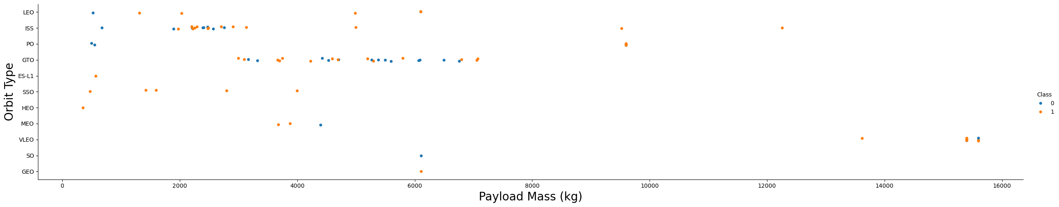
Payload vs. Orbit Type
A scatter point of Payload vs. Orbit type shows once more that heavier flights are more likely to be successful
It also makes it clear that some “100%” success rates (on earlier plot) are a bit artificial, as some orbits include too few launches for this to be predictive

Slide 23
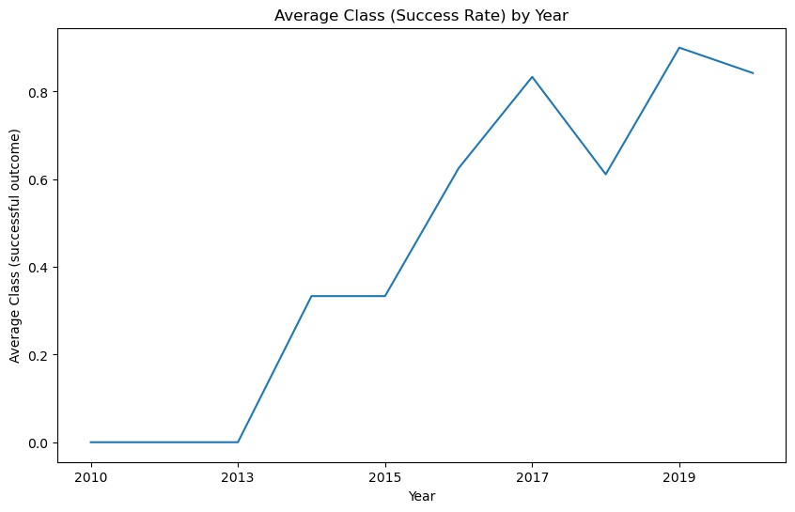
Launch Success Yearly Trend
Average Annual Success rate shows a steady trend upward, although with a small dip during 2018
We might investigate this further, as to what factors might have caused more failures in this period

Slide 24
Launch Site Names
The launch-site names (unique) found in the data were:
Launch_Site
CCAFS LC-40
CCAFS SLC-40
KSC LC-39A
VAFB SLC-4E

Slide 25
Launch Site Names Beginning with 'CCA'
The first 5 records returned, for launch-site names beginning with ‘CCA’
It’s apparent that early flights used less powerful (v1) boosters, to Low Earth Orbit, and were not yet able to land successfully, maybe suggesting a degree of “trial running”
Date | Time (UTC) | Booster_Version | Launch_Site | Payload | PAYLOAD MASS (KG) | Orbit | Customer | Mission Outcome | Landing Outcome
2010-06-04 | 18:45:00 | F9 v1.0 B0003 | CCAFS LC-40 | Dragon Spacecraft Qualification Unit | 0 | LEO | SpaceX | Success | Failure (parachute)
2010-12-08 | 15:43:00 | F9 v1.0 B0004 | CCAFS LC-40 | Dragon demo flight C1, two CubeSats, barrel of Brouere cheese | 0 | LEO (ISS) | NASA (COTS) NRO | Success | Failure (parachute)
2012-05-22 | 7:44:00 | F9 v1.0 B0005 | CCAFS LC-40 | Dragon demo flight C2 | 525 | LEO (ISS) | NASA (COTS) | Success | No attempt
2012-10-08 | 0:35:00 | F9 v1.0 B0006 | CCAFS LC-40 | SpaceX CRS-1 | 500 | LEO (ISS) | NASA (CRS) | Success | No attempt
2013-03-01 | 15:10:00 | F9 v1.0 B0007 | CCAFS LC-40 | SpaceX CRS-2 | 677 | LEO (ISS) | NASA (CRS) | Success | No attempt

Slide 26
Total Payload Mass - for NASA
The total payload launched where NASA was the customer
total_payload_kg
45596

Slide 27
Average Payload Mass by F9 v1.1
The average payload mass carried by booster version F9 v1.1 is around 2.5 tonnes
Avg_payload_kg
2534.67

Slide 28
First Successful Ground Landing Date
The date of the first successful landing outcome on ground pad
Earliest_Ground_Pad
2015-12-22

Slide 29
Drone Ship Landings for Payloads 4000 - 6000
A list of the boosters used for successful drone ship landings, where payload mass was between 4000 and 6000 kg
Booster_Version
F9 FT B1021.2
F9 FT B1022
F9 FT B1026
F9 FT B1031.2

Slide 30
Total mission counts by success and failure
Counts of the successful and failed (overall) mission outcomes
Mission_outcome | nFlights
Failure | 1
Success | 100

Slide 31
Boosters Which Carried Maximum Payload
A list of the boosters which have carried the maximum payload mass
Booster_Version
F9 B5 B1048.4
F9 B5 B1048.5
F9 B5 B1049.4
F9 B5 B1049.5
F9 B5 B1049.7
F9 B5 B1051.3
F9 B5 B1051.4
F9 B5 B1051.6
F9 B5 B1056.4
F9 B5 B1058.3
F9 B5 B1060.2
F9 B5 B1060.3

Slide 32
2015 Launch Records
For drone-ship landing failures in 2015, list the month name, landing_outcome, booster version, and launch site name
monthName | Landing_Outcome | Booster_Version | Launch_Site
January | Failure (drone ship) | F9 v1.1 B1012 | CCAFS LC-40
April | Failure (drone ship) | F9 v1.1 B1015 | CCAFS LC-40

Slide 33
Rank Landing Outcomes 2010-06-04 to 2017-03-20
Rank the counts for each type of landing outcome (such as Failure (drone ship) or Success (ground pad)), in descending order
Examine records only between 2010-06-04 and 2017-03-20
landing_outcome | nOfType | MostFreq
No attempt | 10 | 1
Failure (drone ship) | 5 | 2
Success (drone ship) | 5 | 2
Controlled (ocean) | 3 | 4
Success (ground pad) | 3 | 4
Failure (parachute) | 2 | 6
Uncontrolled (ocean) | 2 | 6
Precluded (drone ship) | 1 | 8

Slide 34

Launch Site Proximity Analysis - Section
Section 3

Slide 35

<Folium Map Screenshot 1>
Replace <Folium map screenshot 1> title with an appropriate title
Explore the generated folium map and make a proper screenshot to include all launch sites’ location markers on a global map
Explain the important elements and findings on the screenshot

Slide 36
<Folium Map Screenshot 2>
Replace <Folium map screenshot 2> title with an appropriate title
Explore the folium map and make a proper screenshot to show the color-labeled launch outcomes on the map
Explain the important elements and findings on the screenshot

Slide 37
<Folium Map Screenshot 3>
Replace <Folium map screenshot 3> title with an appropriate title
Explore the generated folium map and show the screenshot of a selected launch site to its proximities such as railway, highway, coastline, with distance calculated and displayed
Explain the important elements and findings on the screenshot

Slide 38

Build a Dashboard with Plotly Dash - Section
Section 4

Slide 39
<Dashboard Screenshot 1>
Replace <Dashboard screenshot 1> title with an appropriate title
Show the screenshot of launch success count for all sites, in a piechart
Explain the important elements and findings on the screenshot

Slide 40
<Dashboard Screenshot 2>
Replace <Dashboard screenshot 2> title with an appropriate title
Show the screenshot of the piechart for the launch site with highest launch success ratio
Explain the important elements and findings on the screenshot

Slide 41
<Dashboard Screenshot 3>
Replace <Dashboard screenshot 3> title with an appropriate title
Show screenshots of Payload vs. Launch Outcome scatter plot for all sites, with different payload selected in the range slider
Explain the important elements and findings on the screenshot, such as which payload range or booster version have the largest success rate, etc.

Slide 42

Predictive Analysis (Classification) - Section
Section 5

Slide 43
Classification Accuracy
Visualize the built model accuracy for all built classification models, in a bar chart
Find which model has the highest classification accuracy

Slide 44
Confusion Matrix
Show the confusion matrix of the best performing model with an explanation

Slide 45
Conclusions
Point 1
Point 2
Point 3
Point 4
…

Slide 46
Appendix
Include any relevant assets like Python code snippets, SQL queries, charts, Notebook outputs, or data sets that you may have created during this project

Slide 47

Goodbye, and Thanks!

